Slide 1
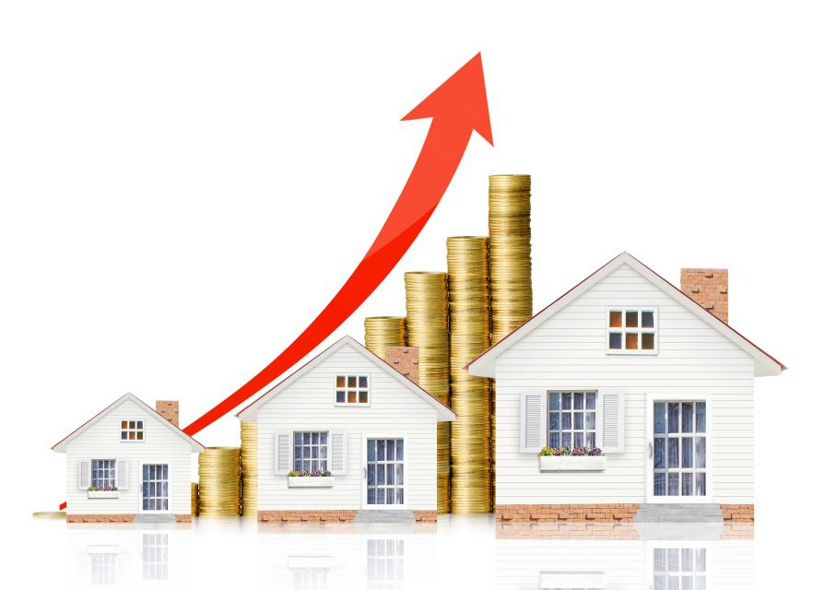
Housing Price Prediction Project
Presented by- Sankalp Mahapatra Internship-29

Slide 2
TABLE OF CONTENTS
INTRODUCTION
Business Problem Framing
Business goal
Motivation for the Problem undertaken
Exploratory Data Analysis (EDA)
Data Visualization
Model/s Development and Evaluation
Hyperparameter tuning using GridSearchCV
Conclusion

Slide 3
INTRODUCTION
Thousands of houses are sold every day. There are some questions every buyer asks himself like: What is the actual price that this house deserves? Am I paying a fair price? Also Is it the location? Is it the overall quality of the house? Is it the size? Could it be sold at a good price in future? All these questions come in to our mind when we decide to purchase a house.
In this study, a machine learning model is proposed to predict a house price based on data related to the house (its size, the year it was built in, etc.). During the development and evaluation of our model, we will show the code used for each step followed by its output. This will facilitate the reproducibility of our work.

Slide 4
Business Problem Framing
Houses are one of the necessary needs of each and every person around the globe and therefore housing and real estate market is one of the markets which is one of the major contributors in the world’s economy. It is a very large market and there are various companies working in the domain. Data science comes as a very important tool to solve problems in the domain to help the companies increase their overall revenue, profits, improving their marketing strategies and focusing on changing trends in house sales and purchases. Predictive modelling, Market mix modelling, recommendation systems are some of the machine learning techniques used for achieving the business goals for housing companies.
The project endeavors to extensive data analysis and implementation of different machine learning techniques in python for having the best model with most important features of a house on insight of both business value and realistic perspective.

Slide 5
Business goal
With the help of available independent variables, we need to model the price of the houses. This model will then be used by the management to understand how exactly the prices vary with the variables. They can accordingly manipulate the strategy of the firm and concentrate on areas that will yield high returns. Further, the model will be a good way for the management to understand the pricing dynamics of a new market.

Slide 6
Motivation for the Problem undertaken
House prices increase every year, so there is a need for a system to predict house prices in the future. House price prediction can help the developer determine the selling price of a house and can help the customer to arrange the right time to purchase a house.
The problem statement is related to the US-based housing company named Surprise Housing has decided to enter the Australian market. The company uses data analytics to purchase houses at a price below their actual values and flip them at a higher price. For the same purpose, the company has collected a data set from the sale of houses in Australia.

Slide 7
The company is looking at prospective properties to buy houses to enter the market. It is required to build a model using Machine Learning in order to predict the actual value of the prospective properties and decide whether to invest in them or not. For this company wants to know:
• Which variables are important to predict the price of house?
• How do these variables describe the price of the house?
In this section, we evaluate widely used regression technologies like Linear Regression, regularization, bagging and boosting and many more ensemble techniques to predict the house sale price result.

Slide 8
Exploratory Data Analysis (EDA)
These are the different steps I have undertaken to perform the Exploratory Data Analysis:
Importing the necessary dependencies and libraries.
Reading the CSV file and converted into data frame.
Checking the data dimensions for the original dataset.
Looking for null values and accordingly fill the missing data.
Checking the summary of the dataset.
Checking unique values and plotting the value counts of each unique value of each column.
Checking all the categorical columns in the dataset.

Slide 9
Visualizing the relation between the features and label and relation between the features i.e. finding multicolinearity by using matplotlib and seaborn.
Performing encoding using the ordinal encoder on categorical features.
Checking for co-relation/multi-colinearity in a heat map.
Checking for Outliers/Skewness using box plot and distribution plot.
Checking how the data is distributed in all the features.
Perform Scaling using Standard Scaler method.
Used Vif to cross check if Multicolinearity still exists in the dataset.

Slide 10
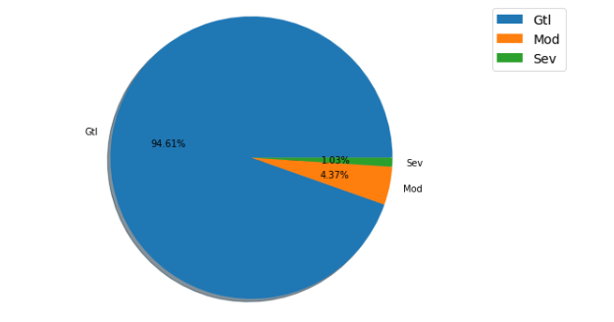
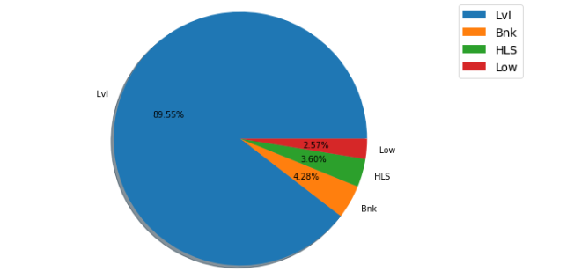
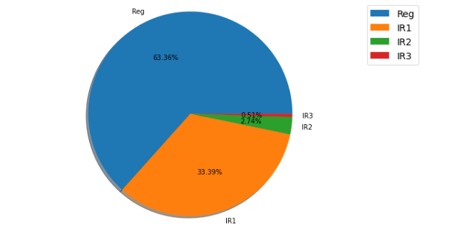
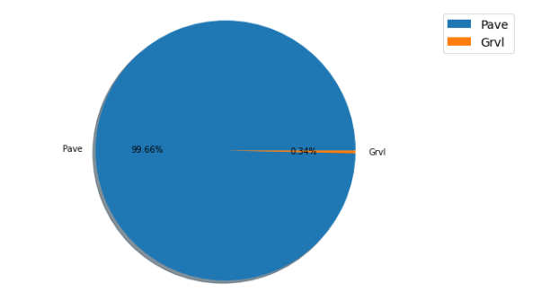
Data Visualization

Slide 11
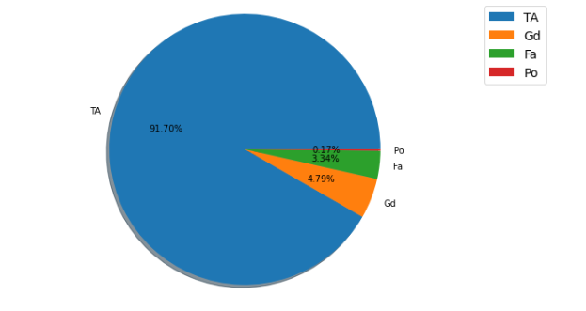
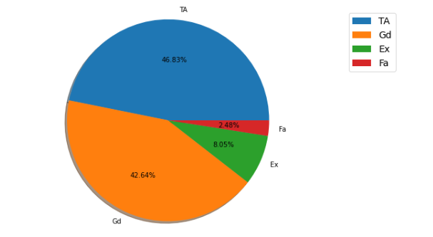
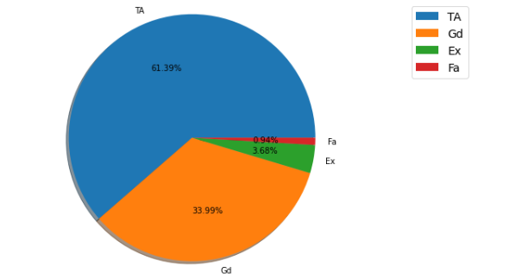
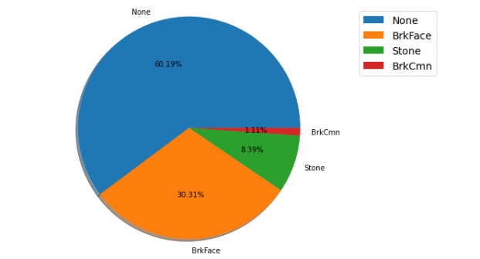

Slide 12
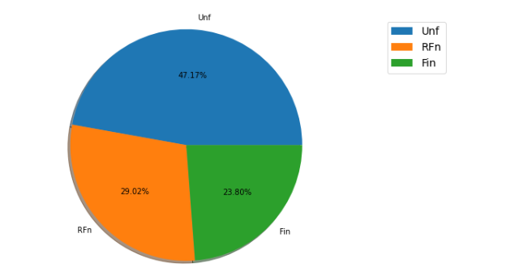
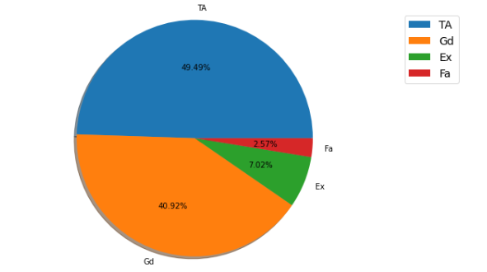
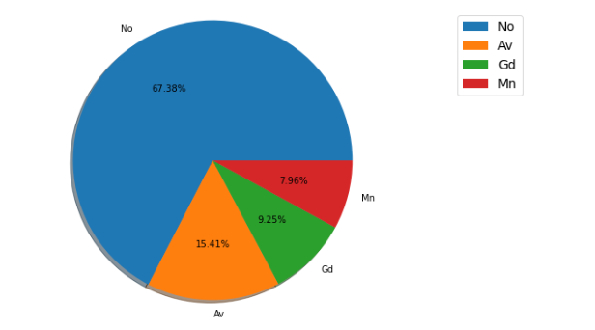
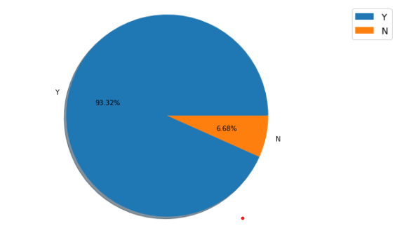

Slide 13
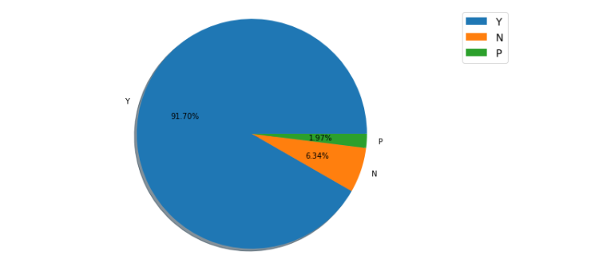

Slide 14
Observation from the Pie plots
The count of road access to the property Paved is 1164 which covers around 99.66% of the property where Graved type has count 4 that is only 0.34%.
The count is high for the property having the shape regular.
The total number of flatness of the property for level is high which has 89.55%.
The slope of the property Gentle slope has very high count of 1105 i.e, 94.61%.
Around 60% of the houses does not have Masonry veneer type and 30% of the houses contains Brick Face type of Masonry veneer.
Around 61% of the houses evaluates typical/average quality of the material on the exterior, 34% of the houses have good quality of the material on the exterior. Only a few have excellent quality.

Slide 15
Most of the houses evaluates typical/average and good quality of height of the basement.
Around 91% of the houses have typical/average condition of the basement.
Around 67% of the houses does not contain any walkout or garden level walls.
93.32% of the houses have central air conditioning.
49% of the houses contains typical/average kitchen quality and 40% of the houses have good kutchen quality. The count for excellent kitchen quality is very low and is around 2%.
47% Of the houses have unfinished garage interior, 29% rough finished and only 23% of the houses' interior garage has finished.
91.70% of the houses contains the paved drive way.

Slide 16
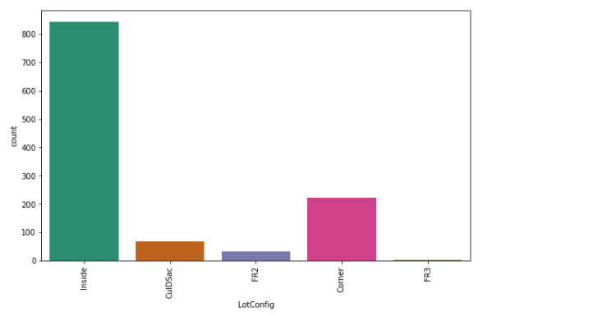
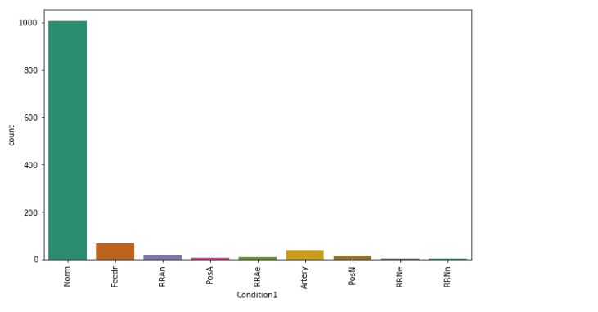
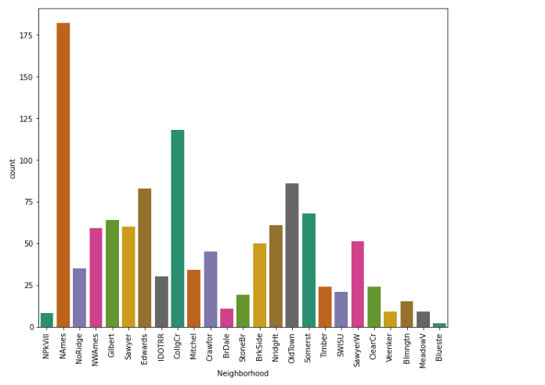
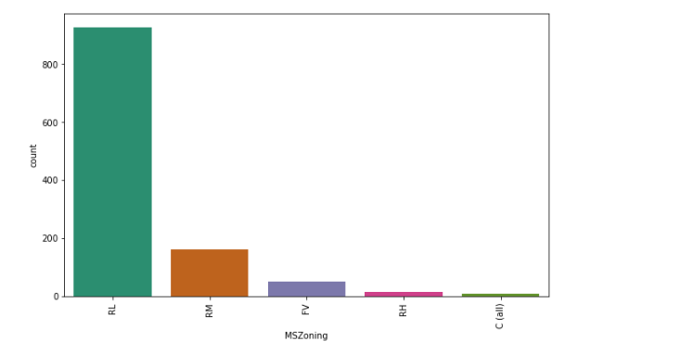

Slide 17
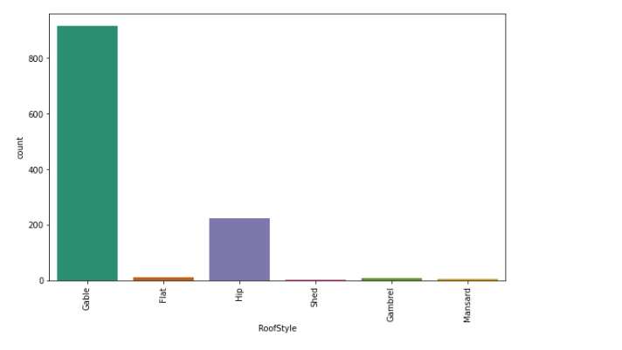
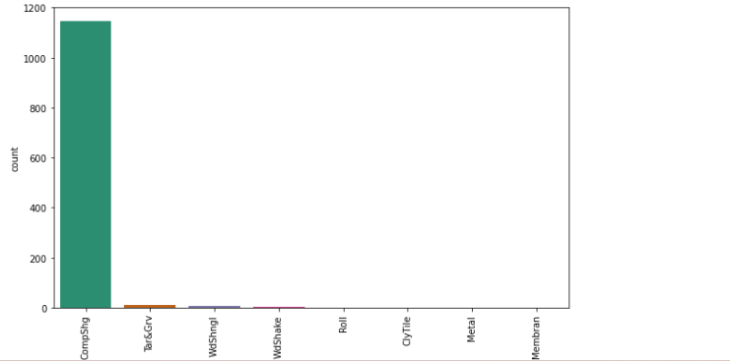
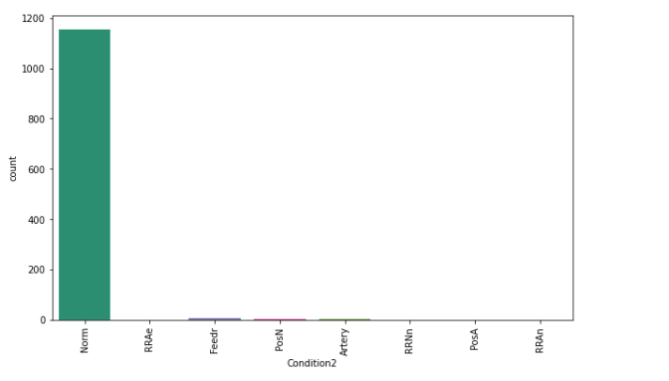
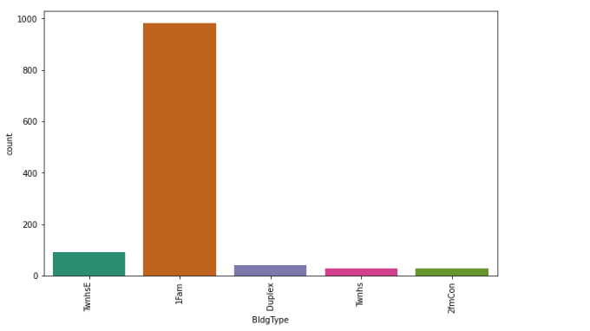

Slide 18
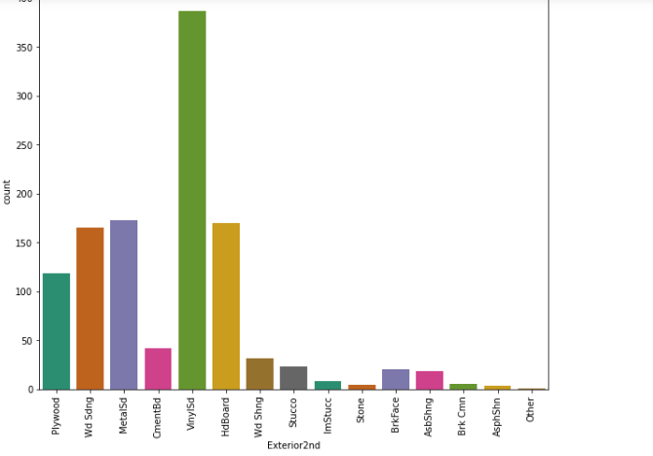
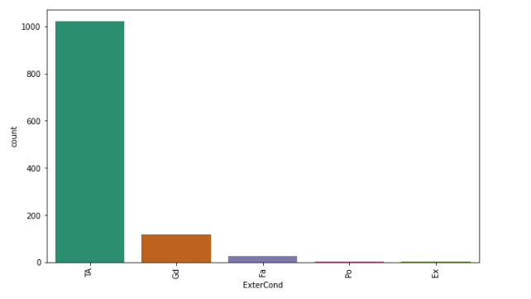
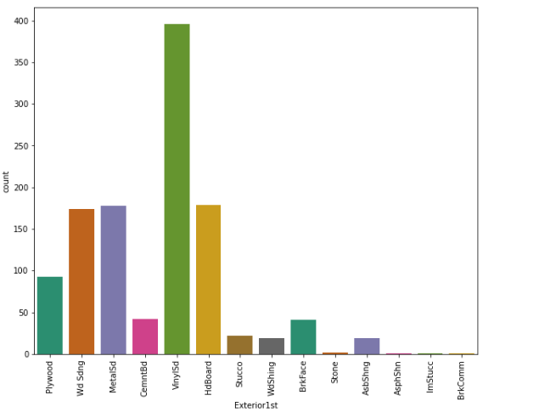
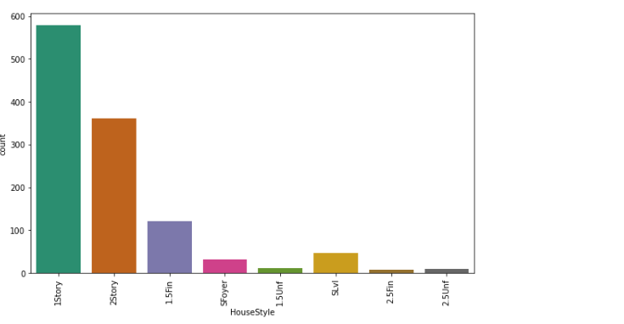

Slide 19
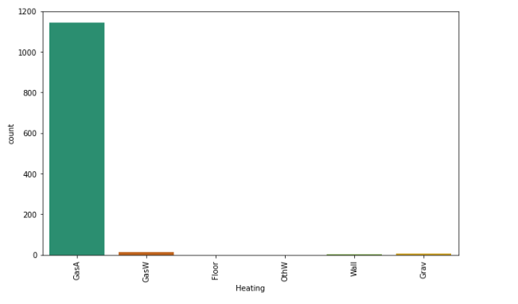
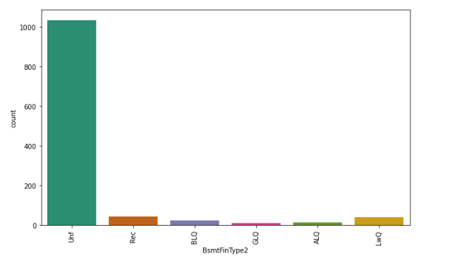
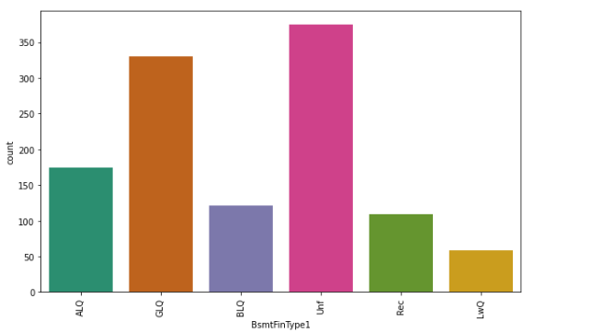
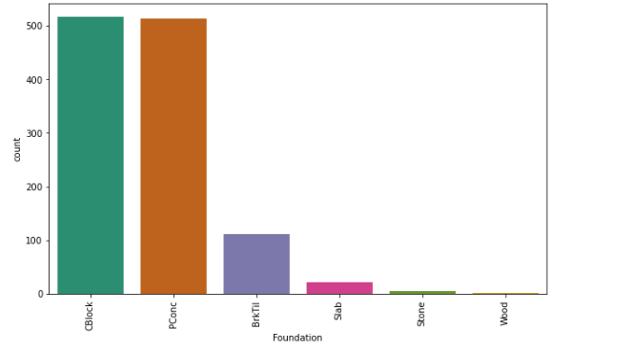

Slide 20
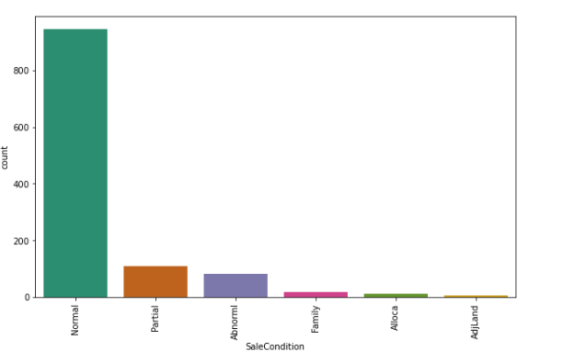
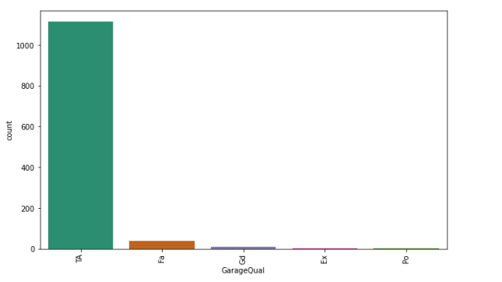
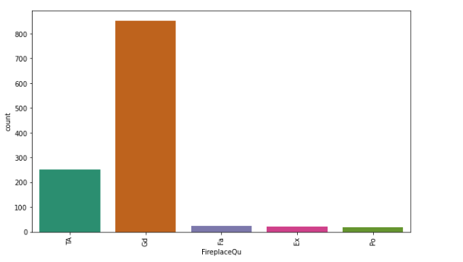
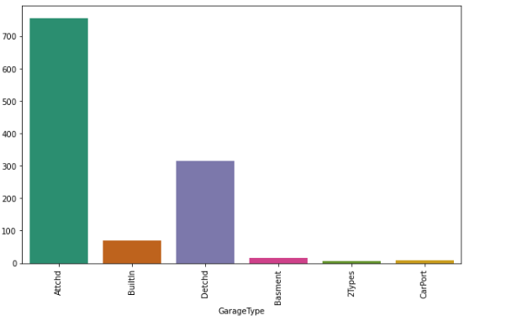

Slide 21
Observations from the count plots
The houses having Residential Low Density zoning of the sale have high count and commercial zoning sale have very less count compared to others.
Inside lot configiration has high count and Frontage on 3 sides of property have very less count compared to others.
The count is high for the North Ames cities floowed by college creek and count is very low for Bluestem.
The count is high for the Normal proximity condition apart from this all the others have very less count.
Similar to condition1, in comdition2 also Normal proximity has very high count compared to others.
Single-family detached dwelling type has very high counts compared to other types have very less count.
1 story style of dwelling has high count followed by 2 story and others have very less count.
The flat type roof has high count and shed has very less count.
The roof material type Standard (Composite) Shingle has highest count and others have very less counts.

Slide 22
Most of the houses have Vinyl Siding exterior covering materials followed by hard board also Brick Common, Asphalt Shingles and Imitation Stucco have very count which means there are no more houses with these types.
Similar to Exterior1st, here also most of the houses have Vinyl Siding exterior covering materials.
The present condition of the material on the exterior for most of the houses are Average/Typical.
Most of the houses have Cinder Block and Poured Contrete type of foundation.
The count is high for the houses having unfinished basement area. Also some houses have Good Living Quarters.
Similar to BsmtFinType1, here also the count is high for unfinished basements.
Most of the houses have Gas forced warm air furnace heating type.
Most of the houses have excellent heating quality and condition also some houses have typical/average HeatingQC and only 1% of the houses have poor heating quality and condition.

Slide 23
The electrical system of the type Standard Circuit Breakers & Romex has very high count which means most of the houses have this facility.
The total number of home functionality of the property for typical functionality have high count compared to others.
The houses with Masonry Fireplace in main level have good quality compared ot others.
The garage location attachec to home has high count also the garage locations detached to home have moderate level of counts. Only few houses have car port and more than one type of garage.
Houses with typical/average garage quality have high count compared to others.
Houses with typical/average garage condition have high count compared to others.
Warranty Deed type of sale has high count followed by Home just constructed and sold(new).
Normal sale has high count also the home which was not completed when last assessed also has average sale condition.

Slide 24
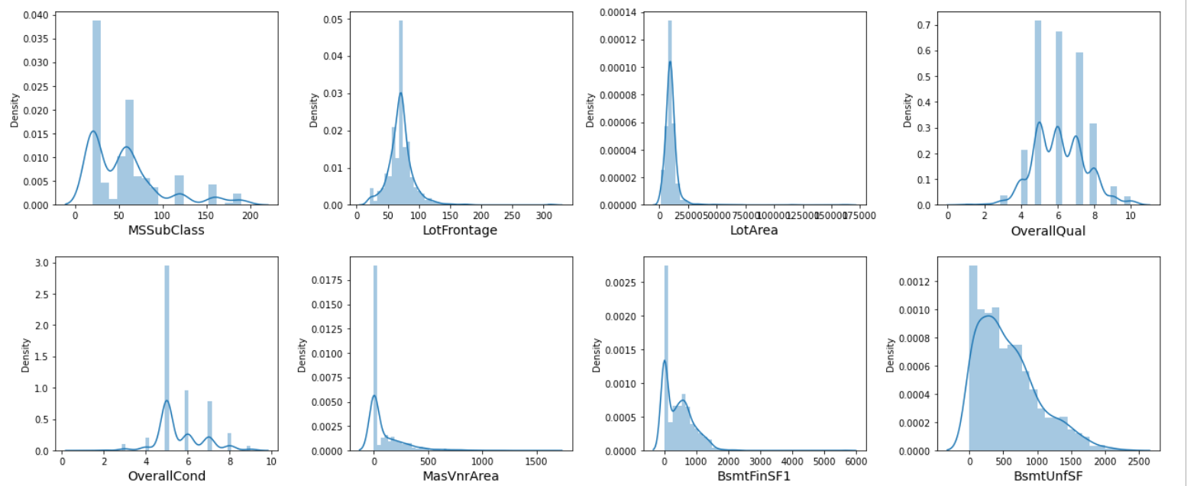
Visualizing the data distribution of all features

Slide 25
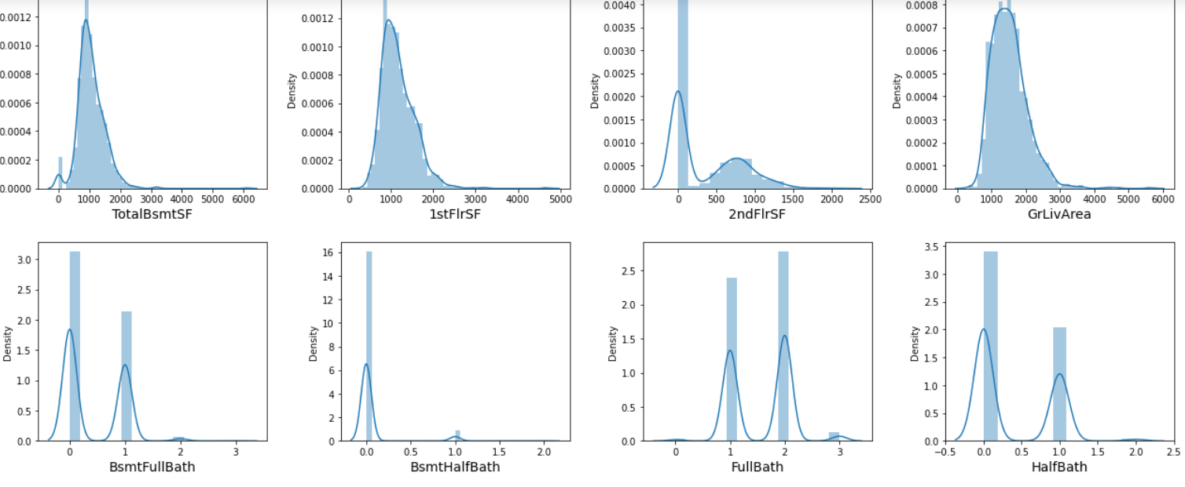

Slide 26
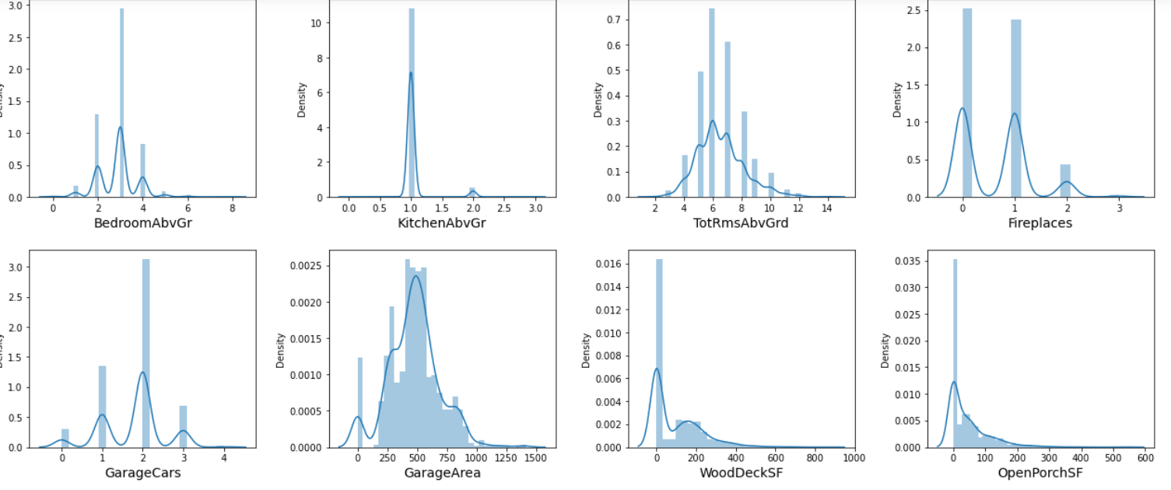

Slide 27
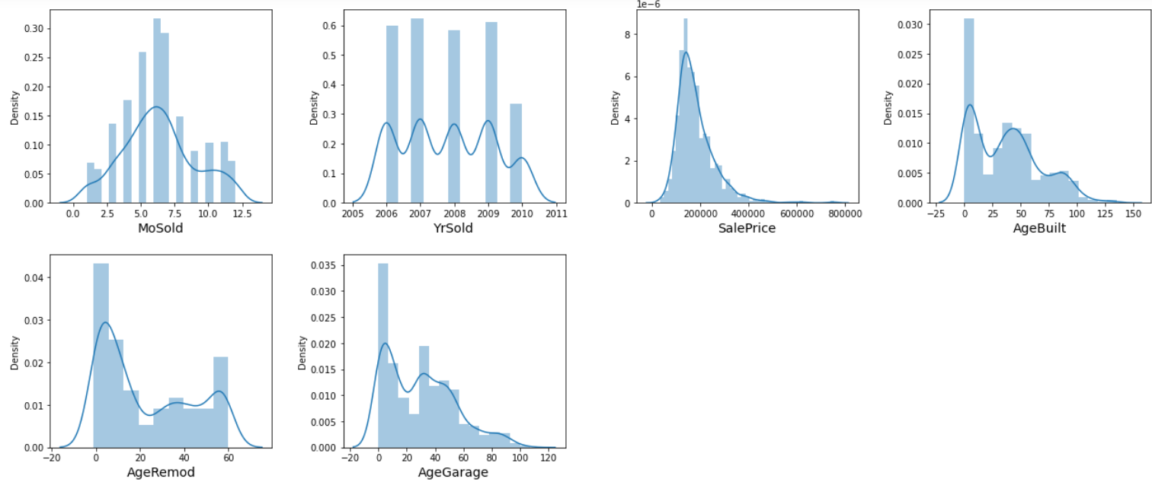

Slide 28
Observations from the distplots:
From the above distribution plot we can observe most of the columns are not normally distributed only some of the columns are almost distributed normally.
Almost all the columns have skewness and are skewed to right. We need to remove this skewness before building our machine learning models.

Slide 29
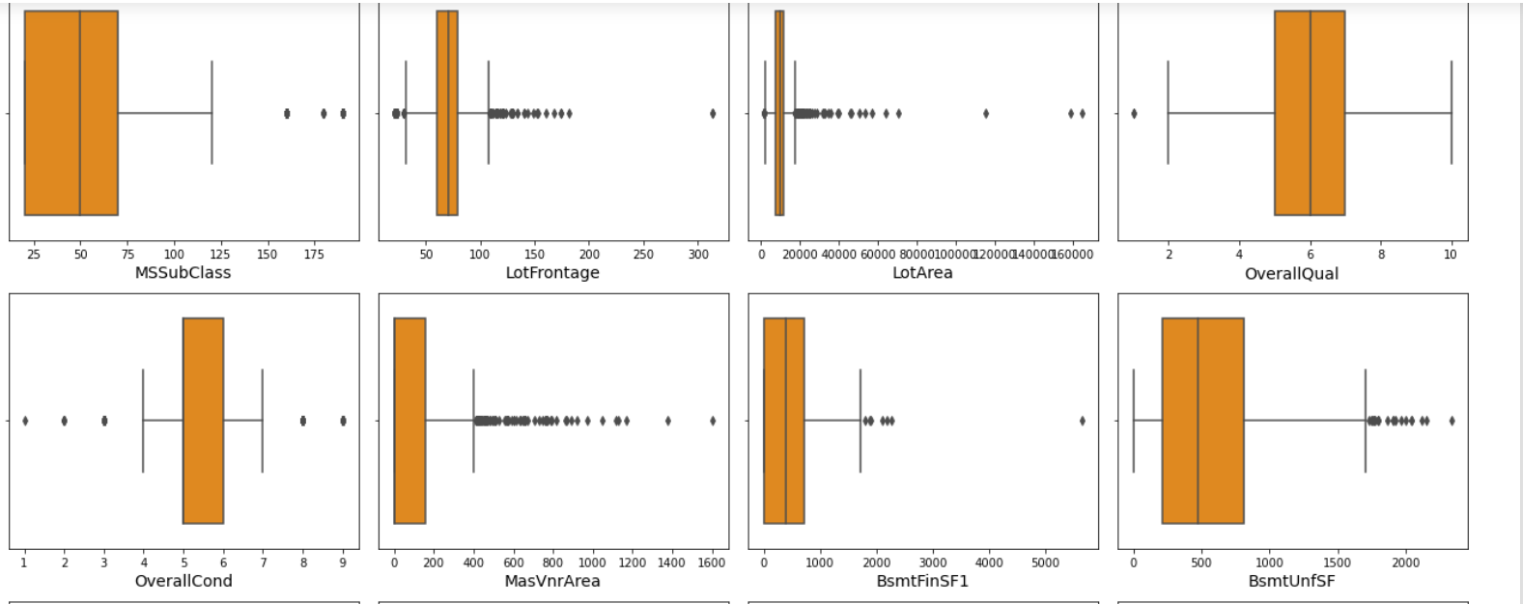
Identifying the outliers by using Boxplots

Slide 30
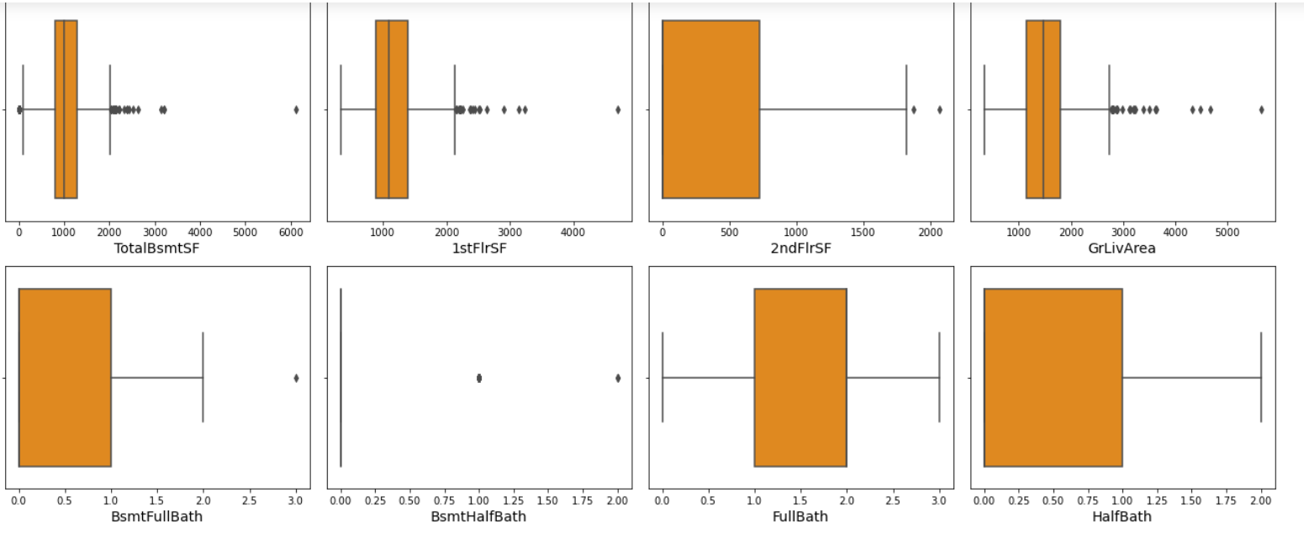

Slide 31
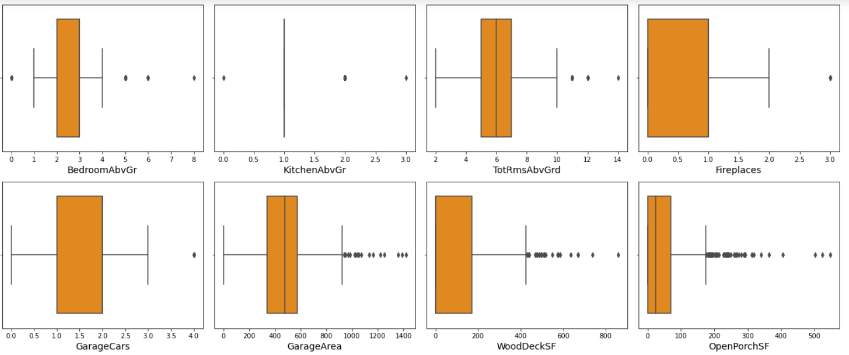

Slide 32
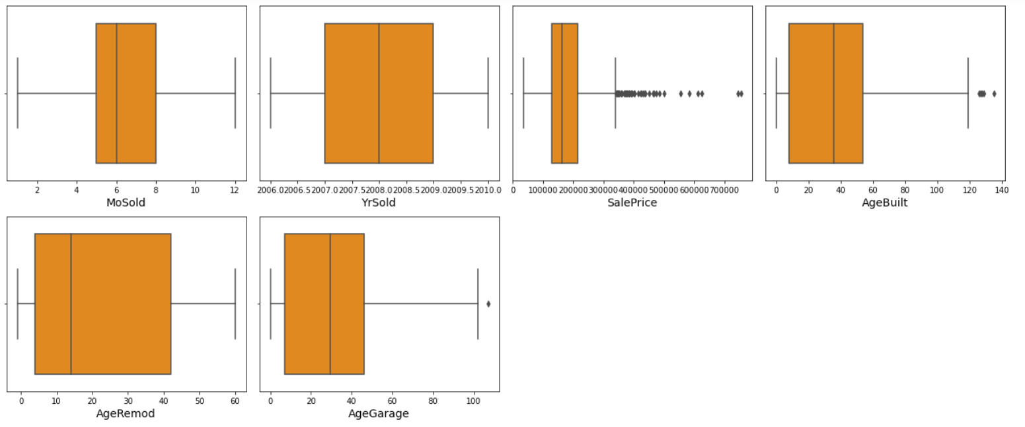

Slide 33
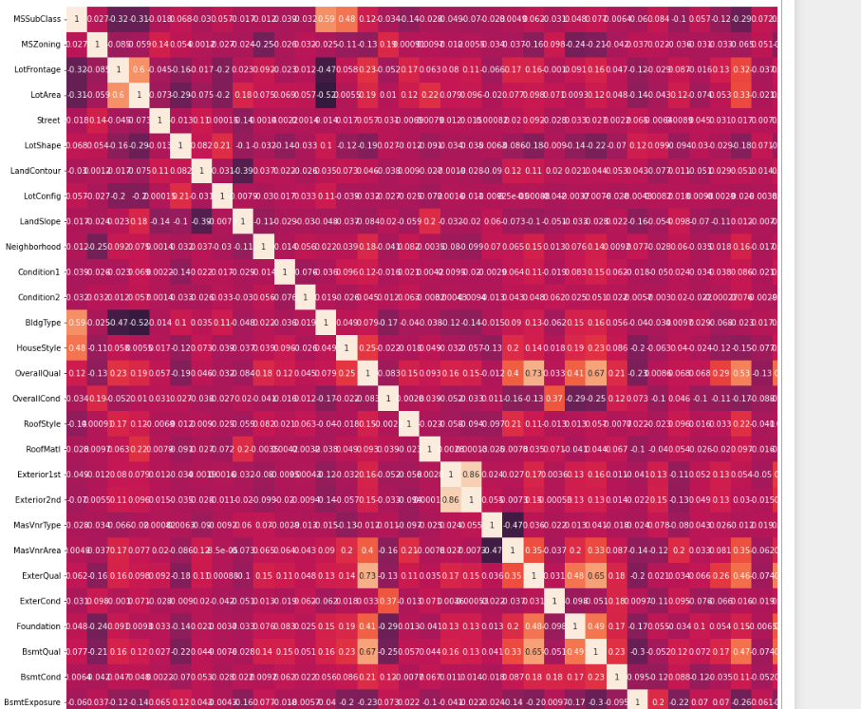
Checking multicolinearity by using Heatmap

Slide 34
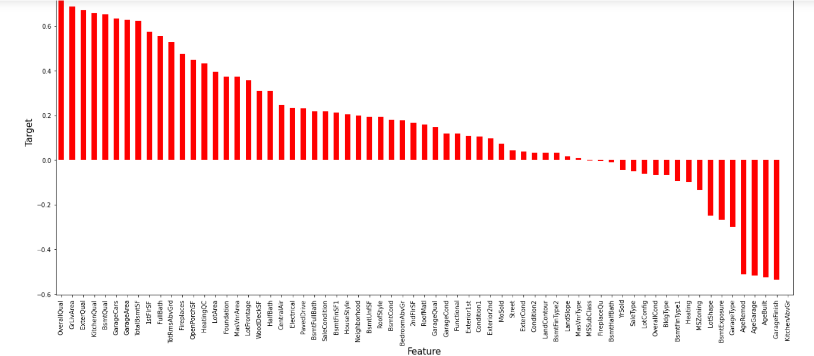
Checking the relationship between the features and the label

Slide 35
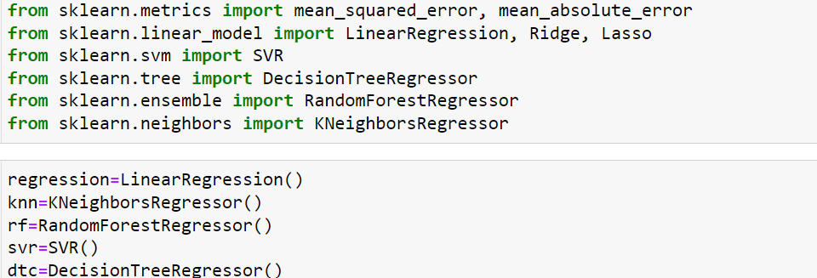
Model Development and Evaluation
Importing the required libraries and declaring the models.

Slide 36
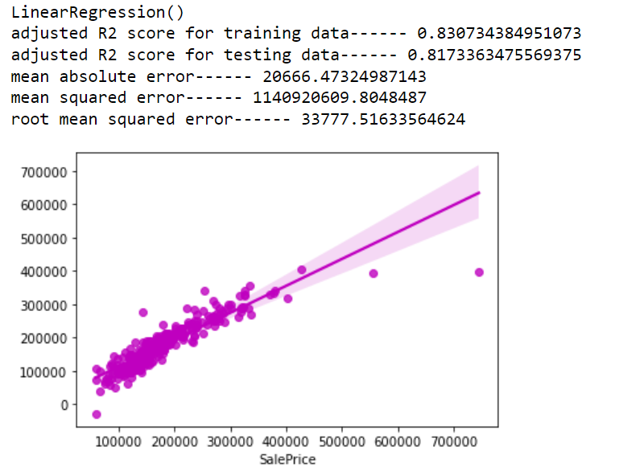
LinearRegression Model

Slide 37
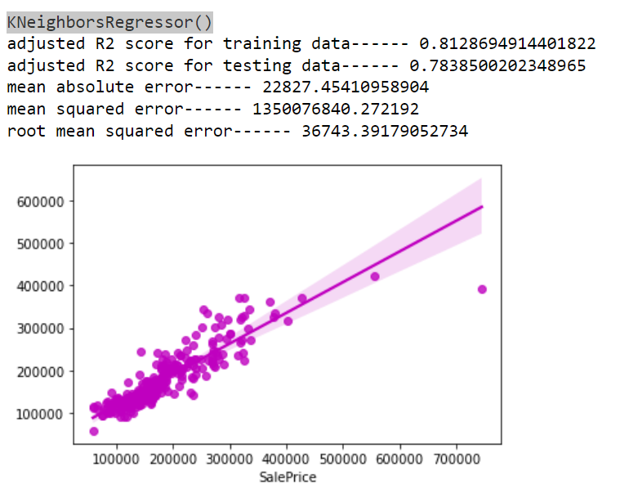
KNeighborsRegressor Model

Slide 38
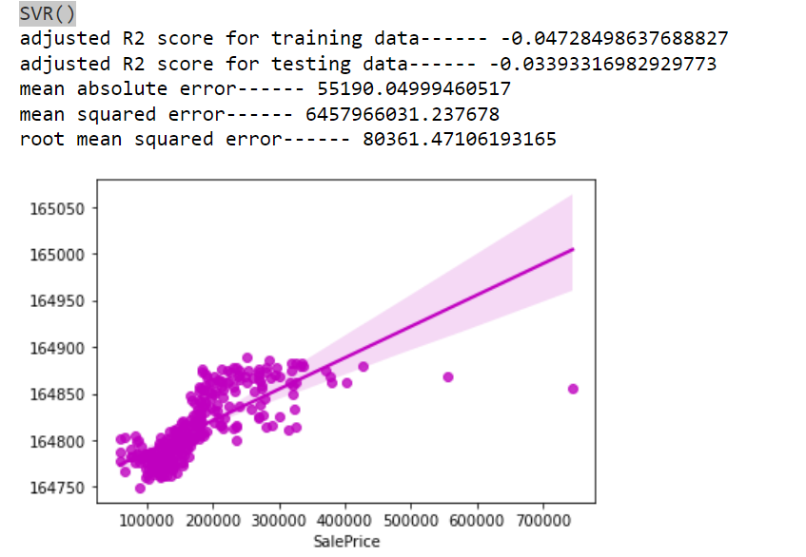
SVR Model

Slide 39
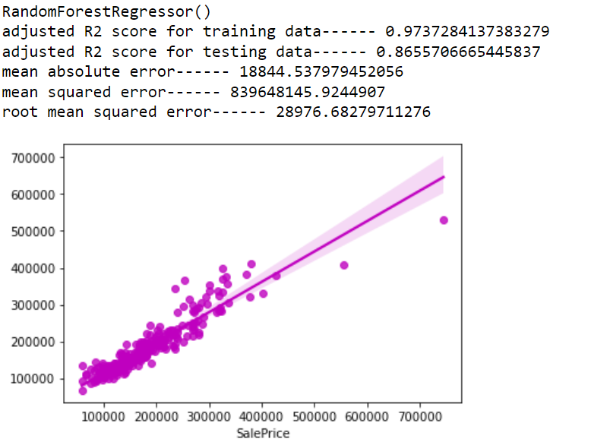
RandomForestRegressor Model

Slide 40
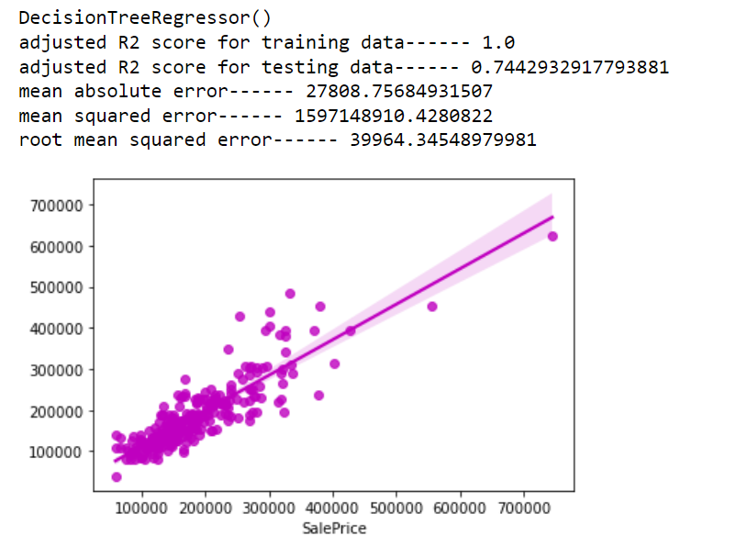
DecisionTreeRegressor Model

Slide 41

Cross-Validation Scores for all the Models

Slide 42
Choosing the best Model
After analyzing all the models we have concluded that RandomForestRegressor() model gives the best R2 score and cross validation score. And based on the R2 score we have chosen RandomForestRegressor() as the best model. We will use RandomForestRegressor() model for further analysis.

Slide 43

Hyperparameter Tuning of RandomForestRegressor() model using GridSearchCV

Slide 44


After using Hyperparameter tuning the accuracy score for RandomForestRegressor Model has increased.

Slide 45
Conclusions
The houses which have very excellent overall quality like material and finish of the house have high sale price. Also we have observed from the plot that as the overall quality of the house increases,the sale price also increases. That is there is good linear relation between SalePrice and OverallQual. So, if the seller builds the house according to these types of qualities that will increase the sale price of the house.
There is a linear relation between the SalePrice and 1stFlrSF. As we have seen as the 1st floor area increases, sales price also increases moderately. So, people like to live in the houses which have only 1-2 floors and the cost of the house also increases in this case.
Also, we have seen the positive linear relation between the SalePrice and GarageArea. As size of garage area increases, sale price also increases.
There is positive linear relation between sale price and TotalBsmtSF. As total basement area increases, sale price also increases.
Using the features which have some relation with target we have built many ML models also seen the increase in accuracy of the best model.

